Slide 1
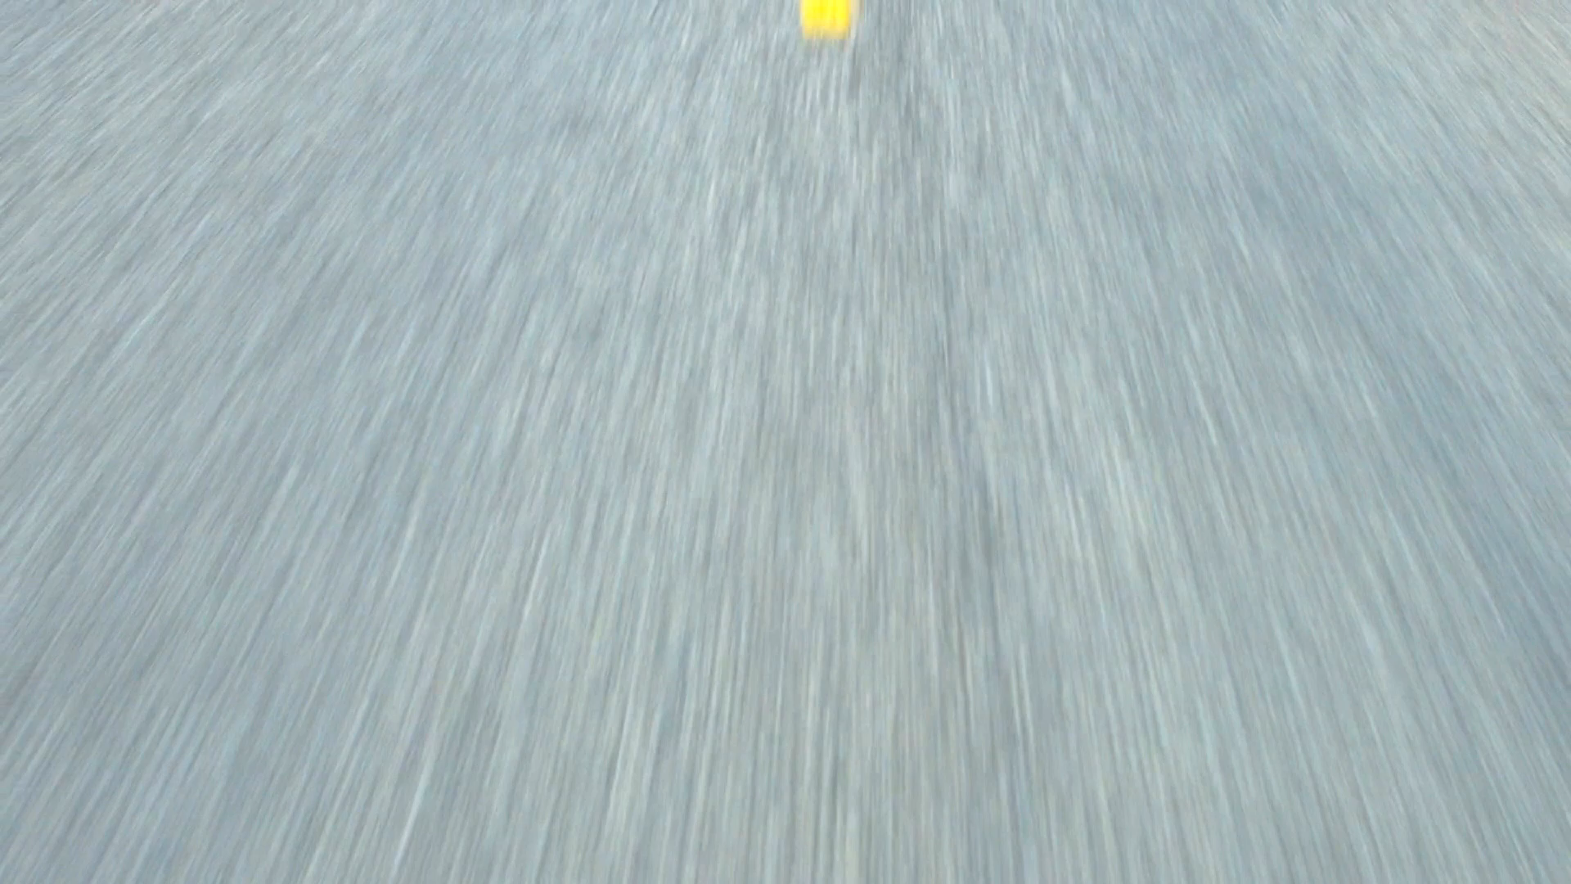
Road Lane Detection Using Computer Vision and Deep Learning
-Aishwarya Madupuri Suresh
-Gowri Kurthkoti Sridhara Rao
-Sivakami Thinnappan

Slide 2
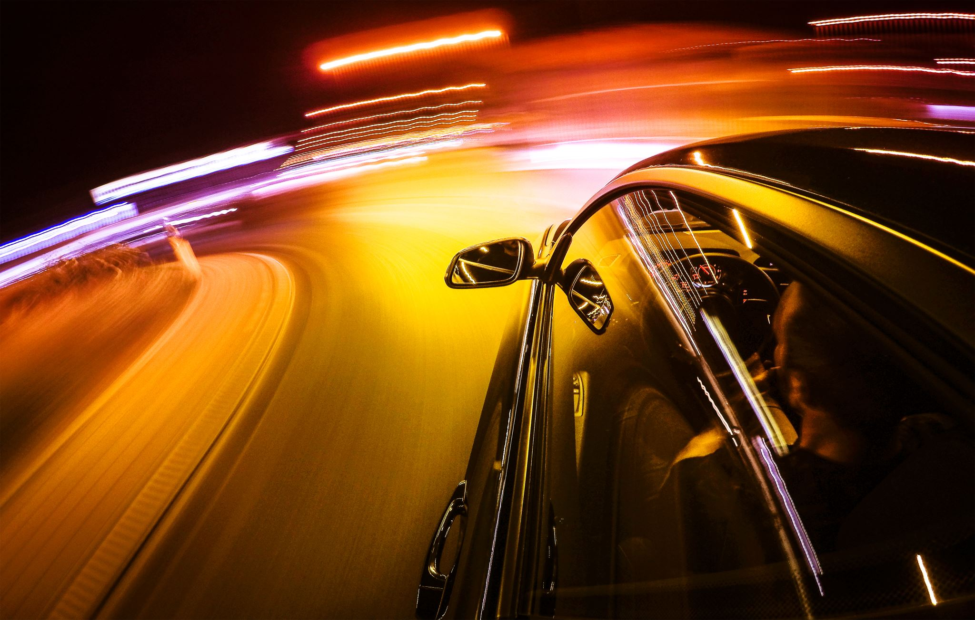
Introduction
Autonomous cars is a popular topic where computer vision is applied.
Driver support technology reduces the workload on the driver which includes intelligent or adaptive cruise control, lane-keeping assists, and hands-free capability
An autonomous car is a vehicle capable of sensing its environment and operating without human involvement.

Slide 3
Background
Autonomous cars rely on sensors, actuators, complex algorithms, machine learning systems, and powerful processors to execute software.
Radar sensors monitor the position of nearby vehicles.
Video cameras detect traffic lights, read road signs, track other vehicles, look for pedestrians and carry out lane assistance.
Sophisticated software then processes all this sensory input, plots a path, and sends instructions to the car’s actuators, which control acceleration, braking, and steering.

Slide 4
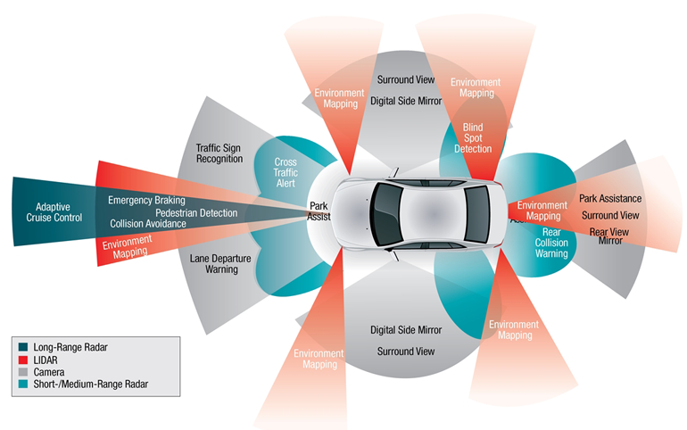

Slide 5
Objectives
Camera-based Lane detection
A comparison between traditional vision feature based method and deep learning-based method
Highlighting the differences and the similarities between these two approaches.

Slide 6
Approaches
Computer Vision approach
Deep learning approach

Slide 7
Computer Vision approach
Canny edge detection
Masking the image not inside region of interest
Identifying all the lines inside the ROI using Hough transform
Averaging the lines to identify the left and right line
Displaying the lines on the frame

Slide 8


Slide 9
Deep Learning Approach
Take in the image of a road
Re-size the image to the size required by the model
Predict the lane to be drawn from the model in green color
Recreate an RGB image of a lane
Merge with the original road image

Slide 10
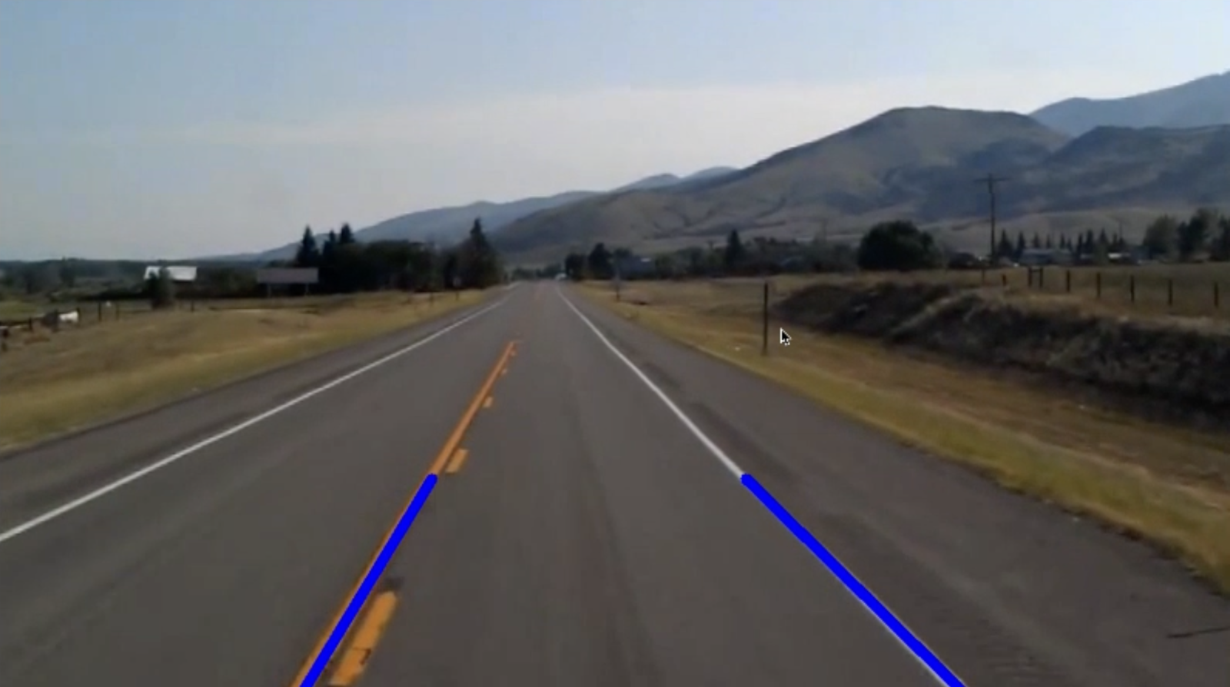
Implementation

Slide 11
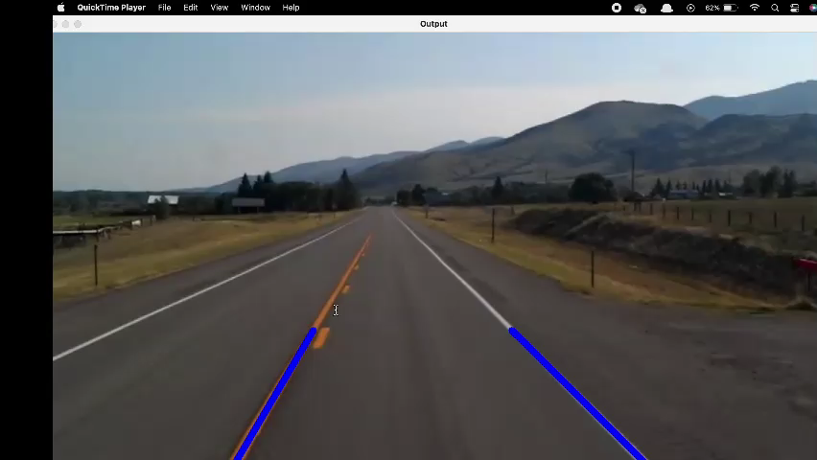
Results (CV)

Slide 12

Results (Deep Learning)

Slide 13
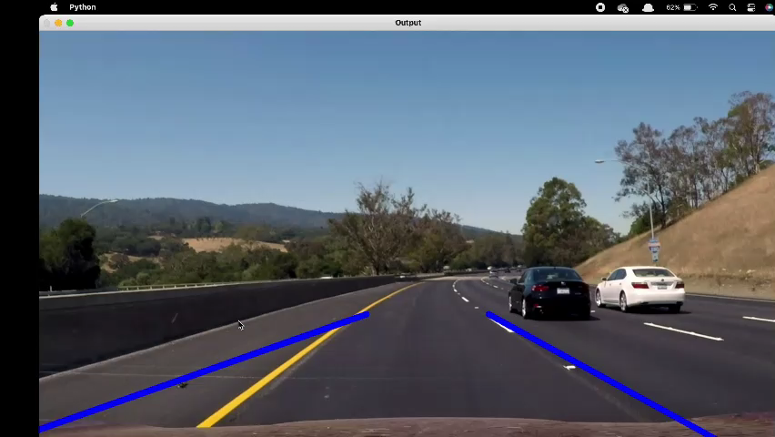
Observations (CV)

Slide 14

Observations (Deep Learning)

Slide 15
Conclusion
Both the methods were implemented, and the results were observed
CV method provides faulty results deviating the detected lanes further away from the actual lines, but it is computationally in-expensive.
Deep learning method can perform accurately for almost all the input videos, but it is computationally expensive.
Both the approaches have their own advantages and disadvantages
In an ideal scenario, it would be best if deep learning methods can be made computationally in-expensive.

Slide 16
Thank you

